Slide 1
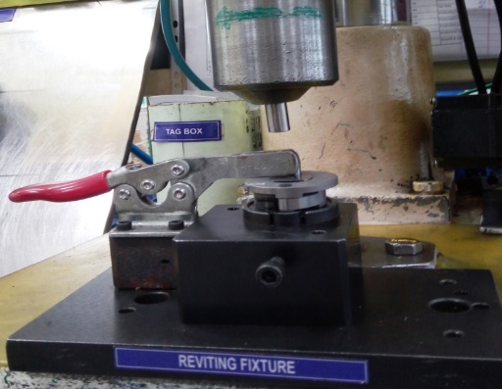
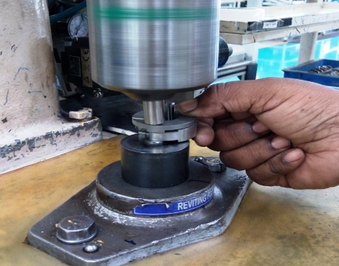
P15
TPM CIRCLE NO :- 01
ACTIVITY
KK
QM
PM
JH
SHE
OT
DM
E&T
KAIZEN IDEA SHEET
TPM CIRCLE NAME: Decomp
LOSS NO. / STEP
DEPT :- ASSEMBLY SHOP
RESULT AREA
P
Q
A
C
D
S
M
B
S
CELL :- A362
CELL NAME:- Dcomp Assly
MACHINE / STAGE :- Riveting stage
OPERATION Riveting
KAIZEN THEME : To improve safety and reduce rejection at riveting stage in A362
IDEA :-Fixture design needs to change
COUNTERMEASURE:-
1) New fixture modified with job holding clamp for job holding by clamp at riveting stage.
BENCHMARK
1 Nos
Problem present status :-Unsafe condition at riveting stage in A362 cell.
TARGET
0 Nos
KAIZEN START
20.07.2016
KAIZEN FINISH
10.08.2016
TEAM MEMBERS: Lalita & chandani , Veershetty, Samadhan Bankar, Pramod Kardile, Janardan Sathe, Nitin Sutar
BENEFITS :-
1)Reduction in unsafe condition.
2) Improve Safety
3)Reduction in in-house rejection
Before
After
KAIZEN SUSTENANCE
WHY - WHY ANALYSIS :-
Why1 :-.Crack riveting found and accident happen at riveting stage.
Why2:-Unsafe condition at riveting stage.
Why3 :-Job holding is by manually during riveting. Why4 :-No proper job holding fixture.
Why5 :-Weak Fixture design for job holding.
RESULT :-
WHAT TO DO: Check daily
HOW TO DO: Visually
FREQUENCY –Daily
SCOPE & PLAN FOR HORIZONTAL DEPLOYMENT
Sr No | CELL | TDC | RESP. | STATUS
ROOT CAUSE : Weak riveting fixture.
REGISTRATION NO. & DATE : 10.09..2016
REGISTERED BY :- Samadhan Bankar
MANAGER’S SIGN :- Janardan Sathe

